Slide 1
SYED HASAN SAEED
Email: hasansaeedcontrol@gmail.com
Web Page: hasansaeed872726549.wordpress.com
shasansaeed.yolasite.com
syedhasansaeed.gnomio.com

Slide 2
BOOKS
AUTOMATIC CONTROL SYSTEM: KUO & GOLANARAGHI
2. CONTROL SYSTEM: ANAND KUMAR
3. AUTOMATIC CONTROL SYSTEM: S. HASAN SAEED
ELECTRICAL MACINE & AUTOMATIC CONTROL: J.B.GUPTA & S. HASAN SAEED
AUTOMATIC CONTROL SYSTEM: R. A . BARAPATE

Slide 3
OUTLINE
Advantages and disadvantages of block diagram.
Terminology.
Closed loop.
How to draw the block diagram.
Block reduction Technique.

Slide 4
BLOCK DIAGRAM REPRESENTATION
BLOCK DIAGRAM:
Block diagram is a pictorial representation of the system.
Block diagram represent the relationship between input and output.
Any complicated system can be represented by connecting the different block.
Each block is completely characterized by a transfer function.

Slide 5
ADVANTAGES OF BLOCK DIAGRAM:
A block may represent a single component or a group of components.
Performance of a system can be determined by block diagram.
Block diagram is helpful for designing and analysis of a system.
Construction of block diagram is simple for any complicated system.
The operation of any system can be easily observed by block diagram representation.

Slide 6
DISADVANTAGES OF BLOCK DIAGRAM:
Source of energy is not shown in the diagram.
Block diagram does not give any information about the physical construction of the system.
Applicable only for linear time invariant system.
It requires more time.
It is not a systematic method.
For a given system, the block diagram is not unique.

Slide 7
Following figure shows the different components of block diagram
Input R(s) C(s) output
The arrow pointing towards block indicates input R(s) and arrow head leading away from the block represent the output C(s).
or
Transfer Function G(S)

Slide 8
The flow of system variables from one block to another block is represented by the arrow. In addition to this, the sum of the signals or the difference of the signals are represented by a summing point as shown in figure.
A C=A+B
+
B
The plus or minus sign at each arrow head indicates whether the signal is to be added or subtracted.
+

Slide 9
Application of one input source to two or more block is represented by a take off point. Take off point also known as branch point, shown below
Forward path: The direction of flow of signal from input to output.
Feedback path: The direction of flow of signal is from output to input.
G1
G2

Slide 10
BLOCK DIAGRAM OF A CLOSED LOOP SYSTEM
r(t) = reference input signal
c(t)= controlled output
e(t)= error signal
b(t)= feedback signal
R(s)=Laplace transform of input
C(s)= Laplace transform of output
B(s) Laplace transform of feedback signal
E(s) Laplace transform of error signal
Block diagram
C(s)
+
R(s)
e(t)
G(s)
E(s)
-
b(t)
H(s)
B(s)

Slide 11
From the figure
The error signal is
From above equations we get

Slide 12
Equation (3) is for negative feedback.
For positive feedback equation (3) becomes

Slide 13
HOW TO DRAW BLOCK DIAGRAM ?
Pneumatic
Valve
Controller
Desired
Level
Actual
Level
Pneumatic
Valve
Controller
Water Tank
Inflow
Float
Block Diagram
Outflow
Water Tank
Liquid Level System
Reference: Modern Control Engineering by K. Ogata

Slide 14
HOW TO DRAW BLOCK DIAGRAM ?
Pneumatic
Valve
Controller
Desired
Level
Actual
Level
Muscles and
valve
Brain
Water Tank
Inflow
Eyes
Block Diagram of human-operated liquid level control system
Outflow
Water Tank
Liquid Level System
Reference: Modern Control Engineering by K. Ogata

Slide 15
HOW TO DRAW BLOCK DIAGRAM ?
Draw the block diagram of the given circuit.
R
V_{i}
L
V_{o}
i

Slide 16
Apply KVL
Laplace Transform of equations (1) & (2) with initial condition zero.

Slide 17
From equations (4) & (5)
From fig.
Laplace transform of above equations

Slide 18
V_{i}(s)
V_{i}(s) –V_{o}(s)
+
-
V_{o}(s)
V_{i}(s)
V_{i}(s) – V_{O}(s)
I (s)
+
1 / R
-
V_{O}(s)

Slide 19
I(s)
V_{o}(s)
sL
Final Block Diag.
V_{i}(s)
I(s)
V_{o}(s)
1 / R
sL
+
-

Slide 20
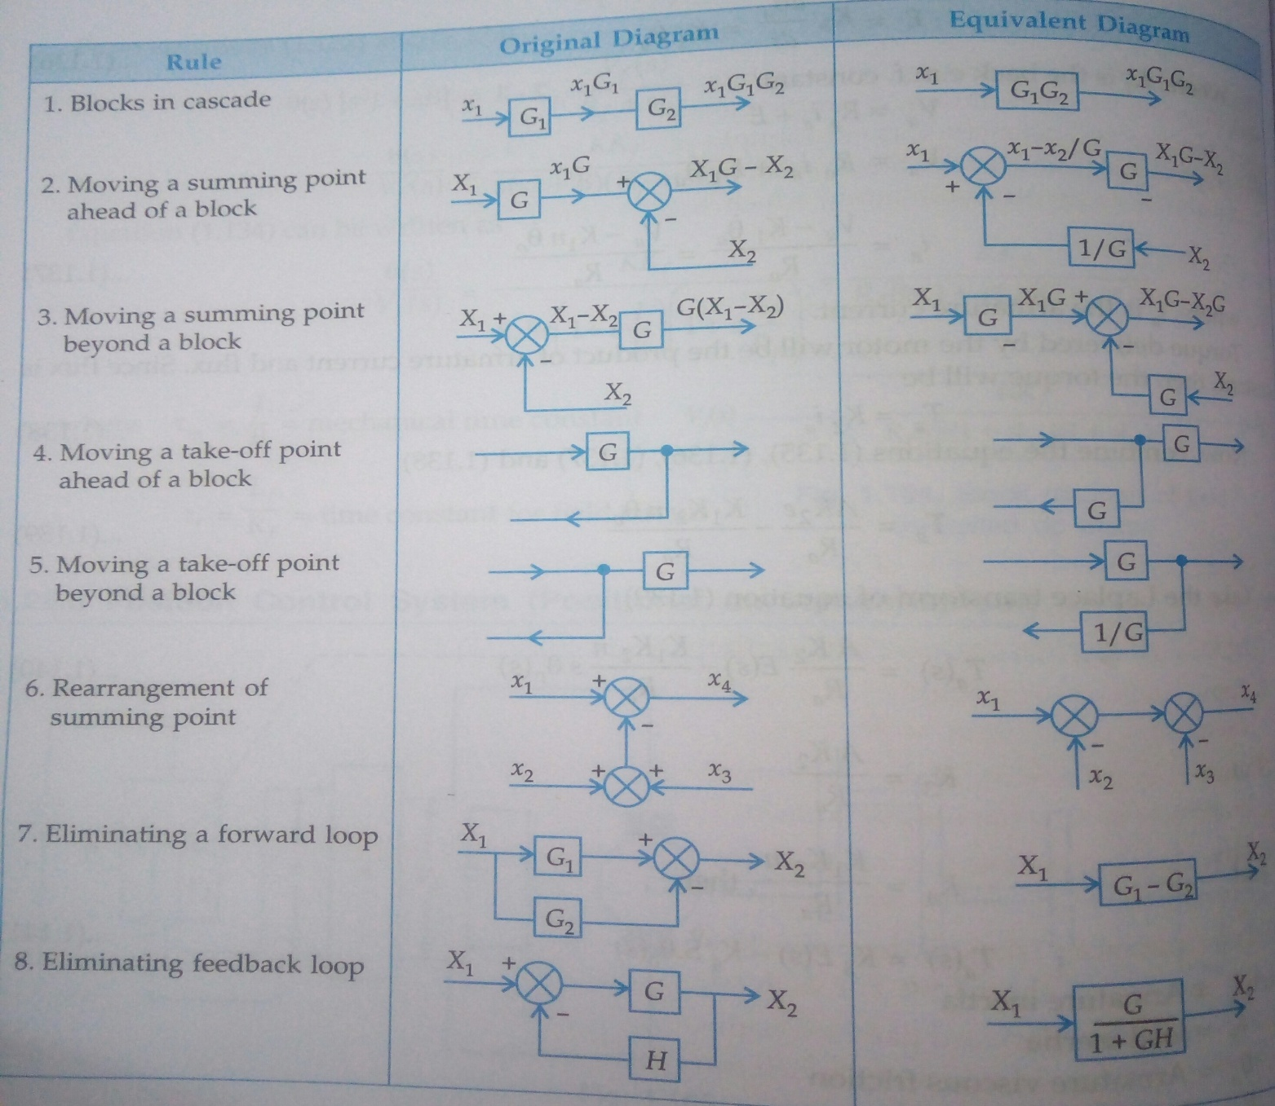
BLOCK DIAGRAM REDUCTION

Slide 21
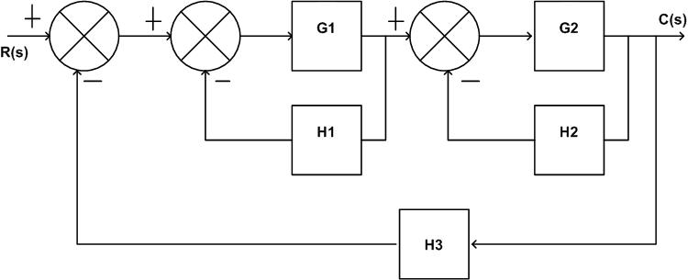
Drive the transfer function using block reduction technique.
Step1: There are two internal closed loop, remove these loops by using closed loop formula

Slide 22

Step 2: Two blocks are cascade
Step 3: Again it is a closed loop
Step 4: required transfer function
R(s)
C(s)

Slide 23

2. Determine the ratio C(s)/R(s) for the system shown in fig.
G₂
+
R(s)
+
+
G₁
C(s)
-
G₂
+
$$\frac{G_{1}}{1+ G_{1}}$$
+
R(s)
+
C(s)

Slide 24
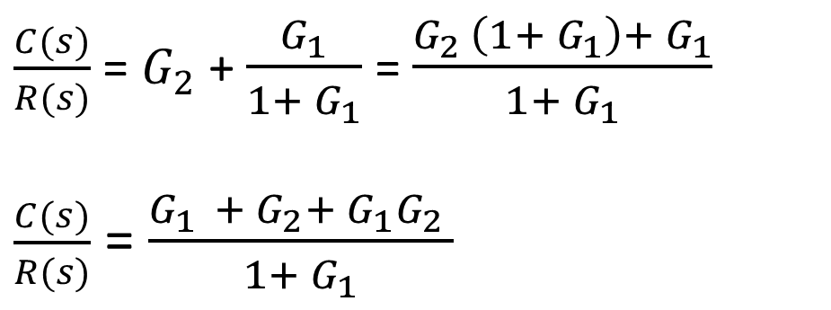

G₂
+
$$\frac{G_{1}}{1+ G_{1}}$$
+
+
R(s)
C(s)
+
$\frac{C(s)}{R(s)}$ = $G_{2}$ + $\frac{G_{1}}{1+ G_{1}}$ = $\frac{G_{2 }\left(1+ G_{1}\right)+ G_{1}}{1+ G_{1}}$
$\frac{C(s)}{R(s)}$ = $\frac{G_{1 }+ G_{2}+ {G_{1}G}_{2} }{1+ G_{1}}$

Slide 25


3. Determine the ratio C(s)/R(s) for the system shown in fig.
G₇
+
+
+
C(s)
R(s)
G₁
G₃
G₄
G₆
-
-
+
G₂
G₅
G₇
$$\frac{G_{1}}{1+ G_{1}G_{2}}$$
$$\frac{G_{4}}{1+ G_{4}G_{5}}$$
+
R(s)
G₃
C(s)
G₆
+

Slide 26
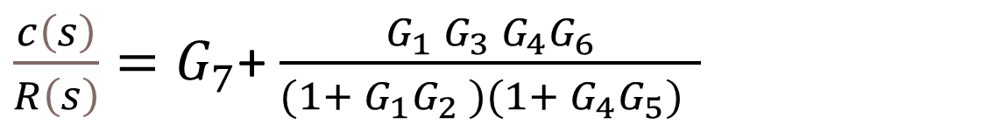


G₇
R(s)
$$\frac{G_{1} G_{3} G_{4}G_{6}}{(1+ G_{1}G_{2} )(1+ G_{4}G_{5}) }$$
+
C(s)
+
${\frac{c\left(s\right)}{R\left(s\right)}=G}_{7}$+ $\frac{G_{1} G_{3} G_{4}G_{6}}{(1+ G_{1}G_{2} )(1+ G_{4}G_{5}) }$
$$\frac{c\left(s\right)}{R\left(s\right)}= \frac{{G_{7}(1+ G_{1}G_{2} )(1+ G_{4}G_{5})+ G}_{1} G_{3} G_{4}G_{6}}{(1+ G_{1}G_{2} )(1+ G_{4}G_{5}) }$$

Slide 27
4. Determine the ratio C(s)/R(s) for the system shown in fig.
H₂
-
R(s)
+
+
+
C(s)
G₁
G₂
G₃
-
-
H₁

Slide 28
4. Determine the ratio C(s)/R(s) for the system shown in fig.
H₂
-
R(s)
+
+
+
C(s)
G₁
G₂
G₃
-
-
H₁

Slide 29
H₂
-
R(s)
+
+
+
C(s)
G₁
G₂
G₃
-
-
H₁
H₂
-
R(s)
+
+
+
C(s)
G₁
G₂
G₃
-
-
H₁/G₃

Slide 30
Closed Loop
H₂
-
R(s)
+
+
+
C(s)
G₁
G₂ G₃
-
-
H₁/ G₃
R(s)
+
+
G₂ G₃
1 + G₂ G₃ H₂
C(s)
G₁
-
-
H₁/ G₃

Slide 31
Closed Loop
R(s)
+
+
G₁ G₂ G₃
1 + G₂ G₃ H₂
C(s)
-
-
H₁/ G₃
Closed Loop
+
G₁ G₂ G₃
1 + G₂ G₃ H₂ + G₁ G₂ H₁
R(s)
C(s)
-

Slide 32
G₁ G₂ G₃
1 + G₂ G₃ H₂ + G₁ G₂ H1 + G1 G2 G3
R(s)
C(s)
C(s)
G₁ G₂ G₃
1 + G₂ G₃ H₂ + G₁ G₂ H₁ + G₁ G₂ G₃
=
R(s)

Slide 33
5. Determine the value of ‘X’ for the system shown in fig. if the transfer function of the system is
C(s)
G₁ G₂
G₃ G₄
=
R(s)
1 - G₃G₄ H₁ + G₂ G₃ H₂ + G₁G₂
G₃ G₄ H₃
X
-
R(s)
+
+
+
C(s)
G₁
G₂
G₃
G₄
-
+
H₁
H₃

Slide 34
X / G₄
-
R(s)
+
+
+
C(s)
G₁
G₂
G₃
G₄
-
+
H₁
H₃
X / G₄
-
R(s)
+
+
+
C(s)
G₁
G₂
G₃G₄
-
+
H₁
H₃

Slide 35
X / G₄
-
R(s)
+
+
G₃G₄
C(s)
G₁
G₂
-
1 - G₃G₄ H₁
H₃
X / G₄
-
R(s)
G₂
C(s)
+
+
G₃G₄
G₁
-
1 - G₃G₄ H₁
H₃

Slide 36
X / G₄
-
R(s)
G₂
C(s)
+
+
G₃G₄
G₁
-
1 - G₃G₄ H₁
H₃
G₂
G₃G₄
G₂
G₂
G₃G₄
1 - G₃G₄ H₁
G₃G₄
1 - G₃G₄ H₁
=
=
G₂
1 - G₃G₄ H₁
G₃G₄
X
1 - G₃G₄ H₁ + G₂ G₃ X
1 - G₃G₄ H₁ + G₂ G₃ X
1 +
1 - G₃G₄ H₁
G₄

Slide 37
R(s)
+
G₂
G₃G₄
C(s)
G₁
-
1 - G₃G₄ H₁ + G₂ G₃ X
H₃
R(s)
+
G₁G₂
G₃G₄
C(s)
-
1 - G₃G₄ H₁ + G₂ G₃ X
H₃

Slide 38
R(s)
+
G₁G₂
G₃G₄
C(s)
-
1 - G₃G₄ H₁ + G₂ G₃ X
H₃
G₁ G₂
G₃G₄
C(s)
1 - G₃G₄ H₁ + G₂ G₃ X
=
R(s)
G₁ G₂
G₃G₄ H₃
1 +
1 - G₃G₄ H₁ + G₂ G₃ X

Slide 39
G₁ G₂
G₃G₄
1 - G₃G₄ H₁ + G₂ G₃ X
=
1 - G₃G₄ H₁ + G₂ G₃ X
1 - G₃G₄ H₁ + G₂ G₃ X + G₁ G₂
G₃G₄ H₃
C(s)
G₁ G₂
G₃G₄
=
R(s)
1 - G₃ G₄ H₁ + G₂ G₃ X + G₁ G₂
G₃G₄ H₃
Compare with the given Transfer Function:
G₁ G₂
G₃G₄
G₁ G₂
G₃G₄
=
1 - G₃G₄ H₁ + G₂ G₃ X + G₁G₂
G₃ G₄ H₃
1 - G₃G₄ H₁ + G₂ G₃ H₂ + G₁G₂
G₃ G₄ H₃
⸫ X = H₂

